Slide 1

Python Fundamentals (week 3)
Louis Rey
UCSD Extension

Slide 2
Week 3 Objectives
File handling
Object Oriented Programming
Classes and the constructor
Writing unit tests
Inheritance
Context managers

Slide 3
File Handling in Python

Slide 4
Opening a File
Before we can read the contents of a file, we must tell Python which file we are going to work with and what we will be doing with the file
This is done with the open( ) function
open() returns a “file handle” - a file object used to perform operations on a file
Similar to ‘File → Open’ in a Word Processor

Slide 5
Using Open ( )
handle = open(filename, mode)
Example: fhand = open(‘mbox.txt’, ‘r’)
Returns a handle used to manipulate the file
filename is a string
mode is optional and should be ‘r’ if we are planning to read the file and ‘w’ if we are going to write to the file

Slide 6
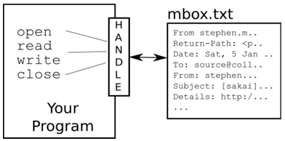
What is a Handle?
>>> fhand = open(‘mbox.txt’)
>>> print (fhand)
<_io.TextIOWrapper name=‘mbox.txt’ mode=‘r’ encoding=‘UTF-8’>

Slide 7
The newline Character
We use a special character called the ‘newline’ to indicate when a line ends
We represent it as \n in strings
Newline is still one character not two
>>> stuff = ‘Hello\nWorld”
>>> stuff
‘Hello\nWorld’
>>> print (stuff)
Hello
World
>>> stuff = ‘X\nY’
>>> print (stuff)
X
Y
>>> len (stuff)
3

Slide 8
File Processing
A text file has newlines at the end of each line
From stephen.marquard@uct.ac.za Sat Jan 5 09:14:16 2008\n
Return-Path: <postmaster@collab.sakaiproject.org>\n
Date: Sat, 5 Jan 2008 09:12:18 -0500\n
To: source@collab.sakaiproject.org\n
From: stephen.marquard@uct.ac.za\n
Subject: [sakai] svn commit: r39772 - content/branches/\n
\n
Details: http://source.sakaiproject.org/viewsvn/?view=rev&rev=39772\n

Slide 9
File Handle as a Sequence
A file handle open for read access can be treated as a sequence of strings where each line in the file is a string in the sequence
We can use the for statement to iterate through the sequence
Remember – a sequence is an ordered set
Xfile = open(‘mbox.txt’)
for choice in xfile:
print (choice)

Slide 10
Counting Lines in a File
Open a file read only access
Use a for loop to read each line
Count the lines and print out the number of lines
fhand = open(‘mbox.txt’)
count = 0
for line in fhand:
count = count + 1
print (‘Line Count: ‘. count)
>>> $ python open.py
Line count: 132045

Slide 11
Reading the *Whole* File
We can read the whole file (newlines and all) into a single string
>>> fhand = open(‘mbox.txt’)
>>> inp = fhand.read ( )
>>> print (len(inp))
94626
>>> print (inp[: 20])
From stephen.marquard

Slide 12
Searching Through a File
We can put an if statement in our for loop to only print lines that meet some criteria
fhand = open(‘mbox.txt’)
for line in fhand:
if line.startswith (‘From:’)
print (line)
The print statement will add an additional newline in addition to the ones already in existence from the file.

Slide 13
Searching Through a File (fixed)
We can strip the whitespace from the right-hand side of the string using rstrip ( ) from the string library
The newline is considered a ‘whitespace’ and is stripped
fhand = open(‘mbox.txt’)
for line in fhand:
line = line. rstrip ( )
if line.startswith (‘From:’)
print (line)
From: stephen.marquard@uct.ac.za
From: louis@media.berkeley.edu
From: zqian@umich.edu
From: rjlowe@iupui.edu
….

Slide 14
Skipping with Continue
We can conveniently skip a line by using the continue statement
fhand = open(‘mbox.txt’)
for line in fhand:
line = line. rstrip ( )
if not line.startswith (‘From:’)
continue
print (line)
Similar to the previous example but this time excludes all the lines that start with From:

Slide 15
Bad File Names
fname = input(‘Enter the file name ’)
try:
fhand = open(fname)
except:
print (‘File cannot be opened:’ , fname )
quit ( )
count = 0
for line in fhand:
if line.startswith (‘Subject:’):
count = count + 1
print (‘There were’, count , ’subject lines in’, fname)
The example above uses error trapping to catch any errors which may be input. The keywords try and except are used.

Slide 16
Importing and Modules

Slide 17
Why Use Modules?
• Code reuse
• Routines can be called multiple times within a program
• Routines can be used from multiple programs
• Namespace partitioning
• Group data together with functions used for that data
• Implementing shared services or data
• Can provide global data structure that is accessed by multiple
subprograms

Slide 18
Importing and Modules
• Use classes & functions defined in another file.
• A Python module is a file with the same name (plus the .py extension)
• Three formats of the command:
import somefile
from somefile import *
from somefile import className
What’s the difference?
What gets imported from the file and what name refers to it after it has been imported.

Slide 19
Import
import somefile
• Everything in somefile.py gets imported.
• To refer to something in the file, append the text “somefile.” to the
front of its name:
somefile.className.method(“abc”)
somefile.myFunction(34)

Slide 20
From … Import *
from somefile import *
• Everything in somefile.py gets imported
• To refer to anything in the module, just use its name. Everything in
the module is now in the current namespace.
• Caveat! Using this import command can easily overwrite the
definition of an existing function or variable!
className.method(“abc”)
myFunction(34)

Slide 21
From … Import …
from somefile import className
• Only the item className in somefile.py gets imported.
• After importing className, you can just use it without a module
prefix. It’s brought into the current namespace.
• Caveat! This will overwrite the definition of this particular name if it
is already defined in the current namespace!
className.method(“abc”) ← This was imported by this command
myFunction(34) ← This one didn’t

Slide 22


Modules and Importing
• Modules are functions and variables defined in separate files
• Items are imported using from or import
• Modules are namespaces
• Can be used to organize variable names, i.e.

Slide 23
Classes and Objects

Slide 24
What is an Object?
• A software item that contains variables and methods
• Object Oriented Design focuses on
• Encapsulation:
— dividing the code into a public interface, and a private implementation of that interface
• Polymorphism:
— the ability to overload standard operators so that they have appropriate behavior based on their context
• Inheritance:
— the ability to create subclasses that contain specializations of their parents

Slide 25
Classes
Structure:
class ClassName:
<statement-1>
.
.
.
<statement-N>
When a class definition is entered, a new namespace is created, and used as the local scope

Slide 26
Classes and Objects
Class objects support two kinds of operations: attribute references and instantiation.
class MyClass:
""" A simple example class """
i = 12345
def f (self):
return 'hello world'
Here MyClass.i and MyClass.f are attribute references
Class instantiation uses function notation
x = MyClass ( )
creates a new instance of the class and assigns this object to the local variable, x

Slide 27



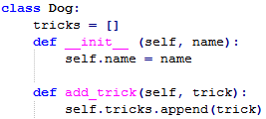

The Constructor
A constructor will set the object to an initial state when an object is first created
Class and Instance Variables

Slide 28
Public and Private Data
• In Python anything with two leading underscores is private
__a, __my_variable
• Anything with one leading underscore is semi-private, and you
should feel guilty accessing this data directly.
_b
• Sometimes useful as an intermediate step to making data private

Slide 29
Unittest

Slide 30
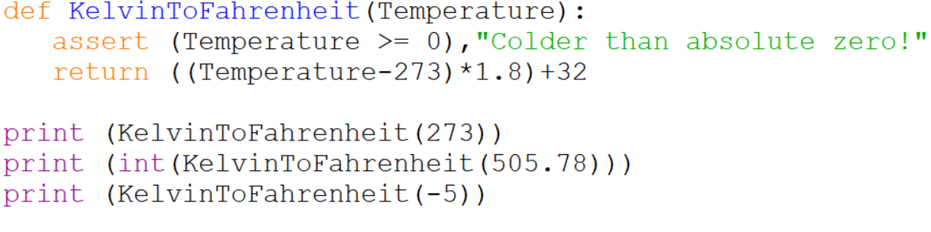
The Assert Statement
• An assertion is a sanity-check that you can turn on or turn off
when you are done with your testing of the program
assert Expression[, Arguments]
• If the assertion fails, Python uses ArgumentExpression as the
argument for the AssertionError

Slide 31
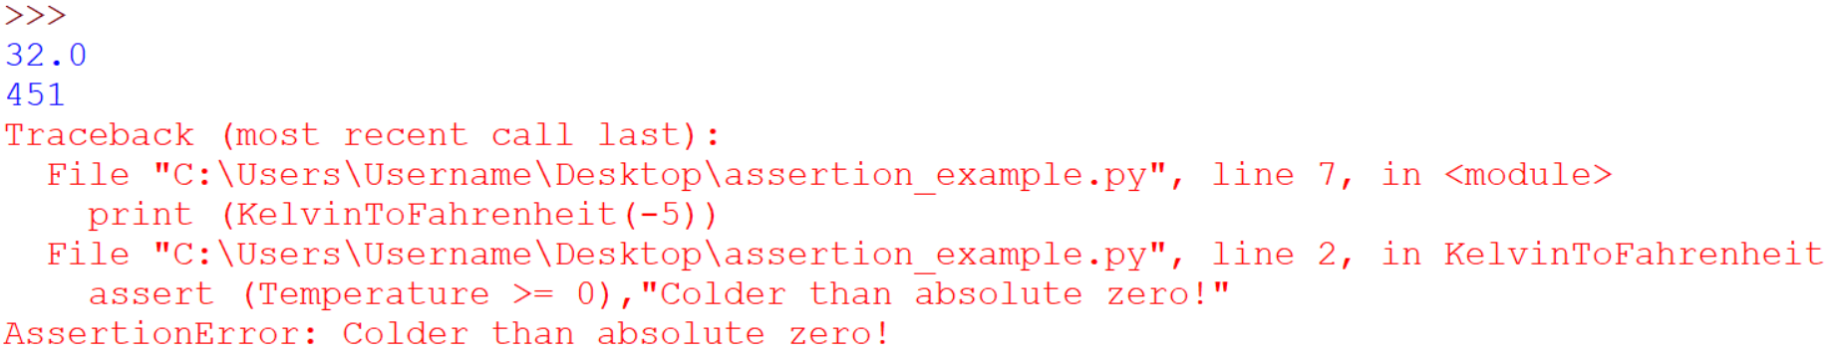
The Assert Statement

Slide 32
The Unittest
The unittest is a unit testing framework used for test automation.
Composed of:
A test fixture, which represents the preparation needed to perform one or more tests, and any associated cleanup actions
A test case, which is the individual unit of testing. It checks for a specific response to a particular set of inputs.
A unittest provides a base class, TestCase, which is a class that may be used to create new test cases
A test suite, which is a collection of test cases, test suites, or both. It is used to aggregate tests that should be executed together.
A test runner, which orchestrates the execution of tests and provides the outcome to the user

Slide 33
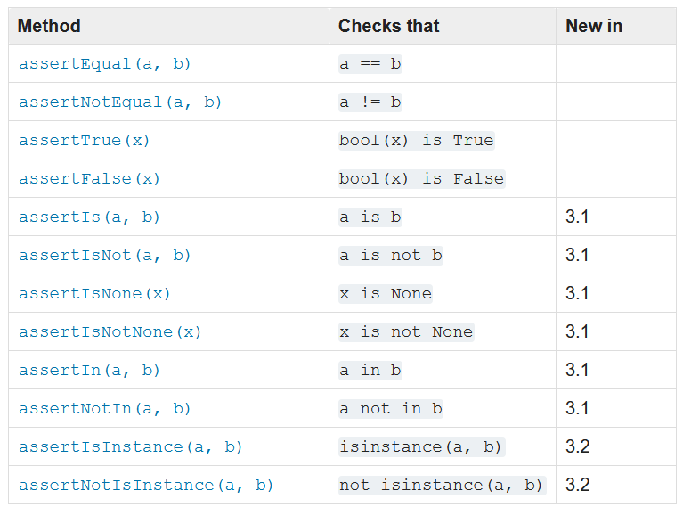
Assert Methods
The TestCase class provides several assert methods to check for and report failures

Slide 34
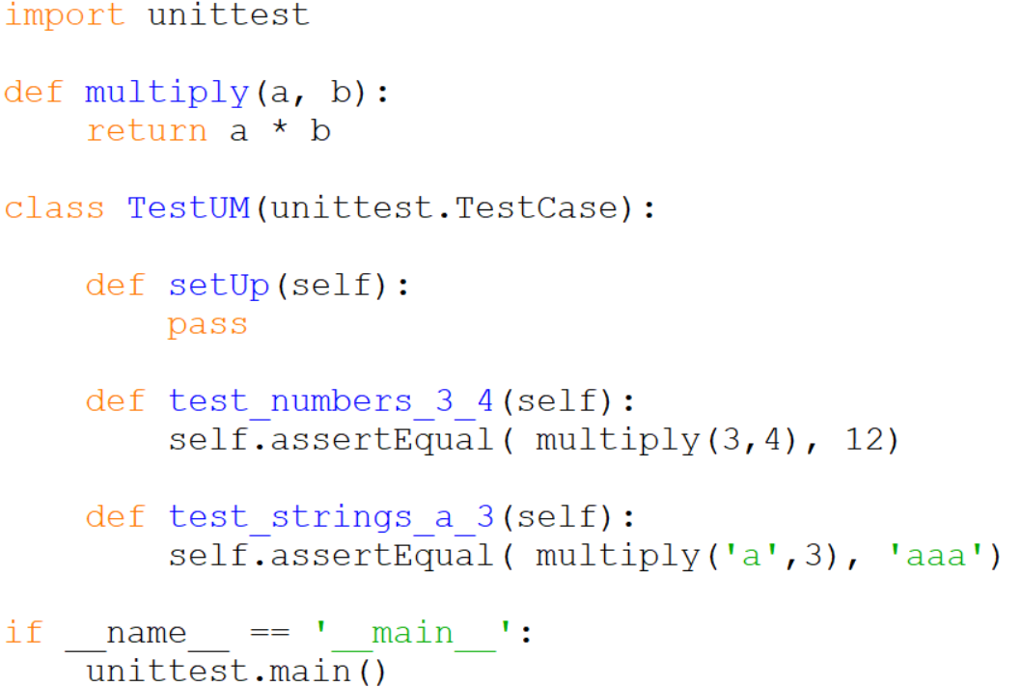
Unittest Example

Slide 35
Object Oriented Programming

Slide 36
Object Oriented Programming
Object-oriented programming (OOP)
Method of structuring a program by bundling related properties and behaviors into individual objects

Slide 37
Object Oriented Programming
Class − A user-defined prototype for an object that defines a set of attributes that characterize any object of the class
The attributes are data members (class variables and instance variables) and methods, accessed via dot notation.
Class variable − A variable that is shared by all instances of a class defined within a class but outside any of the class's methods
Data member − A class variable or instance variable that holds data associated with a class and its objects
Function overloading − Assignment of more than one behavior to a particular function
Instance variable − A variable that is defined inside a method and belongs only to the current instance of a class

Slide 38
Object Oriented Programming
Inheritance − Transfers characteristics of a class to other classes that are derived from it
Instance − An individual object of a certain class
Instantiation − The creation of an instance of a class
Method − A special kind of function that is defined in a class definition
Object − A unique instance of a data structure that's defined by its class. An object comprises both data members (class variables and instance variables) and methods
Operator overloading − The assignment of more than one function to a particular operator.

Slide 39
Class Constructors

Slide 40
The Constructor
A constructor will set the object to an initial state when an object is first created
Class and Instance Variables

Slide 41
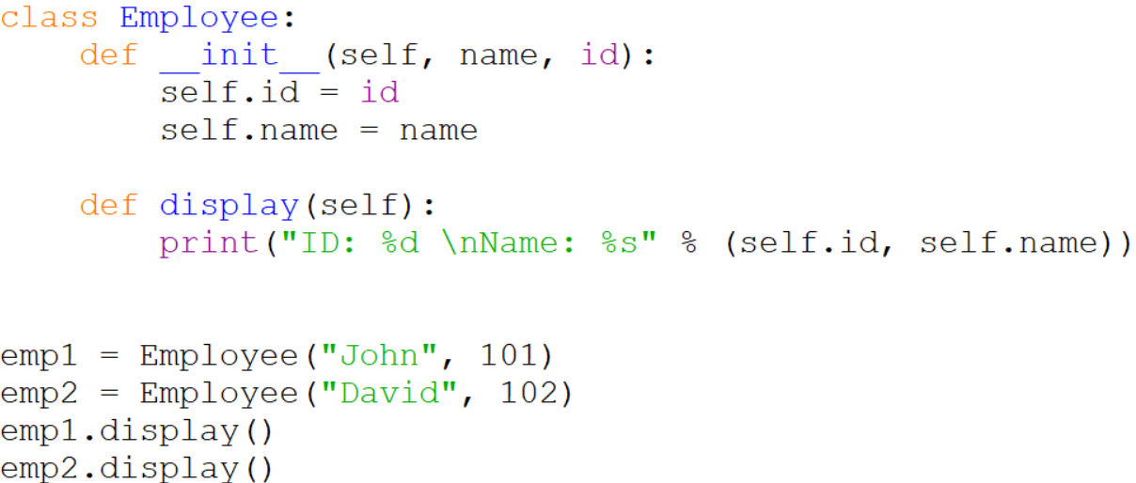
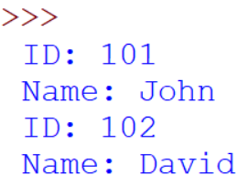
The Constructor

Slide 42
Inheritance

Slide 43
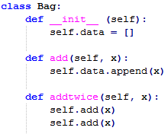
Methods may call other methods by using method attributes of the self argument
Inheritance
class DerivedClassName(BaseClassName):
<statement-1>
.
.
.
<statement-N>

Slide 44
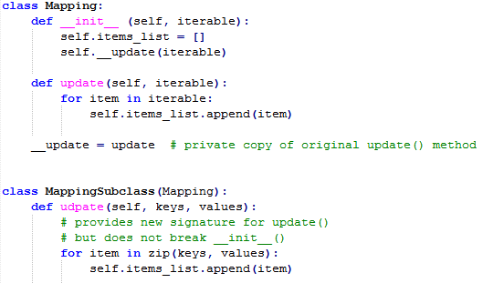
Inheritance

Slide 45
Standard Python Class Methods
__init__: gets called when a new instance of the class is created.
__del__: is called when an instance is about to be destroyed, which lets you do any clean-up e.g. closing file handles or database connections
__repr__ and __str__: Both return a string representation of the object, but __repr__ should return a Python expression that can be used to re-create the object. The more commonly used one is __str__, which can return anything.
__cmp__: Called to compare the object with another object. Note that this is only used with Python 2.x.
__lt__, __le__, __eq__, __ne__, __gt__ and __ge__: Called to compare the object with another object. These will be called if defined, otherwise Python will fall-back to using __cmp__.
__hash__: Called to calculate a hash for the object, which is used for placing objects in data structures such as sets and dictionaries.
__call__: Lets an object be "called" e.g. so that you can write things like this: obj(arg1,arg2,...).

Slide 46
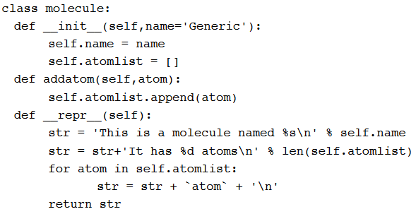
Module Class

Slide 47
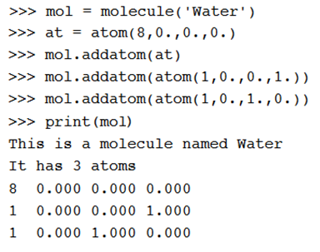
Using Module Class
• Note that the print function calls the atoms print function
• Code reuse: only have to type the code that prints an atom once; this means that if you change the atom specification, you only have one place to update.

Slide 48
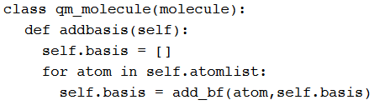
Inheritance
• __init__, __repr__, and __addatom__ are taken from the parent
class (molecule)
• Added a new function addbasis() to add a basis set
• Another example of code reuse
• Basic functions don't have to be retyped, just inherited
• Less to rewrite when specifications change

Slide 49
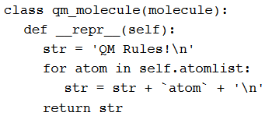
Overloading
• Now we only inherit __init__ and addatom from the parent
•We define a new version of __repr__ specially for QM

Slide 50
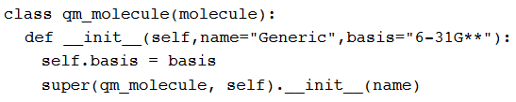
Adding to Parent Functions
• Sometimes you want to extend, rather than replace, the parent
functions.

Slide 51
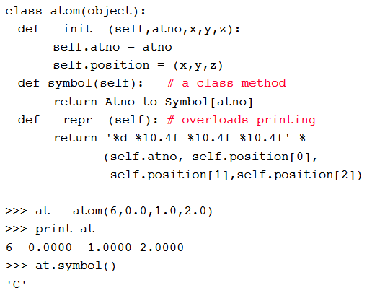
Example

Slide 52
Atom Class
• Overloaded the default constructor
• Defined class variables (atno, position) that are persistent and local to
the atom object
• Good way to manage shared memory:
• instead of passing long lists of arguments, encapsulate some of this data into an object, and pass the object.
• much cleaner programs result
• Overloaded the print operator
• We now want to use the atom class to build molecules...

Slide 53
Context Managers

Slide 54
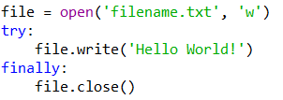

Context Managers
Allows you to allocate and release resources when needed
Uses the with statement
Can execute related blocks of code
Can be written as

Slide 55
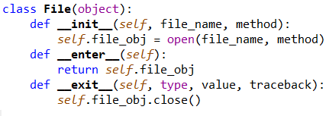

Context Manager in Classes:
A context manager may have an __enter__ and __exit__ method defined
By defining __enter__ and __exit__ methods we can use the new class in a with statement

Slide 56
Context Manager in Classes:
The __exit__ method accepts three arguments, required as part of a Context Manager class
The with statement stores the __exit__ method of the File class
It calls the __enter__ method of the File class
The __enter__ method opens the file and returns it
The opened file handle is passed to opened_file
We write to the file using .write()
The with statement calls the stored __exit__ method
The __exit__ method closes the file

Slide 57
Resources
Matt Huenerfauth (Penn State)
Guido van Rossum (Google)
Richard P. Muller (Caltech)
Bill Boyd (Weslayan University)
Smithsonian Telescope Data Center
Programming Python, Mark Lutz
Fundamentals of Python, Kenneth Lambert

